Slide 1
DBMS

Slide 2
Why DBMS
Understand Application better
Understand HLD/LLD better
Better Test Case/ Test Execution
Test Data Preparation
Access Controls and Authentication

Slide 3
What is Data
Facts related to any object is called as Data
For Ex: Persons Name, Age, Gender, Height, Weight etc..

Slide 4
What is DataBase
It is a systematic collection of Data.
It supports storage and Manipulations.
Data Management becomes easy.

Slide 5
What is DBMS?
It stands for Database Management System
It is collection of programs which enables its user to access Database, Manipulate Data and Much More..

Slide 6
DBMS Models
Flat File
Hierarchical
XML
RDBMS

Slide 7
Flat file Data Base
In Flat file database all the information is stored in one single table.
Records and data are stored in one place.
An ideal database for small projects and organizations.
It does not need complex hardware and software structures.
Not suitable for complex projects
Ex: CSV file with data of employees in a small organization

Slide 8
Hierarchical DB
While the hierarchical database architecture is tree-like
It is simple to create
Child records can have a single-parent record
There is no many-to-one or many-to-many mapping
They have only one-to-many mapping which makes it ideal for cases like drop-down menus or folders and files stored in that folder.

Slide 9
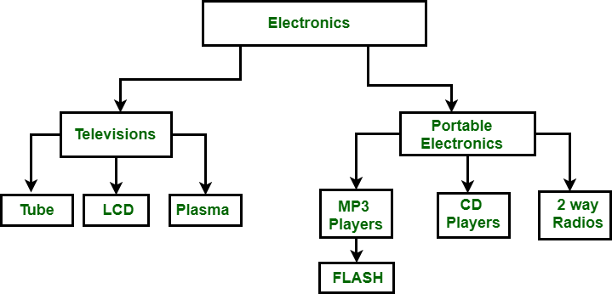

Slide 10
XML Database Model
XML database is a data persistence software system used for storing a huge amount of information in XML format.
It provides a secure place to store XML documents.
It provides nested tag features which are usually discouraged in RDBMS

Slide 11
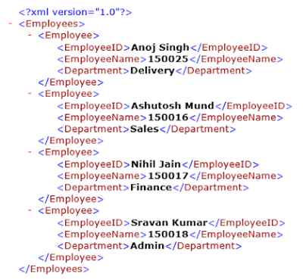

Slide 12
RDBMS?
It stands for Relational Database Management System.
It is a type of DBMS which defines relationships in the form of tables.

Slide 13

Levels of a DBMS architecture – 3 Schema architecture
External Level
External Level
Conceptual Level
Internal Level
Database

Slide 14
Internal view is also known as physical schema which stores the details on how the information will be stored.
It stores information like space allocations, encryption techniques etc.
Conceptual design stores the design of the DB and how the data are related to each other. Programmers and DB admins work at this level
External level is for end-user interaction where the data is displayed based on the user type. It only shows data that a particular user is interested in and hides the other information

Slide 15
DBMS Constraints
Domain Constraints
Ex: Data type, length, range, nullable etc
Entity Integrity constraint
Ex: Primary key
Referential integrity constraint
Ex: Foreign key
Uniqueness Constraint

Slide 16
Normalization
Normalization is a technique used to remove data redundancies in database.
A large database with a single table can result in duplicate data.
This makes it difficult to maintain and update records in DB.
Wastage of disk space
Normalization is a process of decomposing the relations into relations with fewer attributes.
Normalization divides the larger table into smaller and links them using relationships.

Slide 17
To normalize a database we have various Normal forms like 1NF, 2NF, 3NF and BCNF
Normal | Description
1NF | Eliminating repeating groups
2NF | All non key attributes are dependent on Primary key
3NF | No Transition dependency
BCNF | A Stronger definition of 3NF

Slide 18
1NF
A relation will be 1NF if it contains an atomic value.
It states that an attribute of a table cannot hold multiple values. It must hold only single-valued attributes.
Emp_ID | Emp_Name | Phone | State
1 | Peter | 776888484, 988888886 | Bihar
2 | Ram | 988076658, 775645333 | Karnataka
3 | Vinay | 9900567777 | Kerala

Slide 19
2NF
Relation must be in 1NF
All non-key attributes are fully functional dependent on the Candidate key
AB → C No Partial dependency
Stud_No | Course_No | Course-Fee
1 | C1 | 5000
2 | C2 | 10000
1 | C3 | 15000
3 | C2 | 10000
4 | C4 | 7000

Slide 20
3NF
Relation must be in 2NF
No Transitive dependency
X → Y → Z
No non-prime must determine any non-prime
Name | Roll Number | Branch | Fees
Shiva | 1 | CSE | 35000
Rashmi | 2 | EC | 30000
Peter | 3 | EC | 30000
John | 4 | Civil | 20000

Slide 21
Boyce Code Normal form
Table should be in 3rd normal form
LHS should be a Super key
Non Prime attribute cannot determine the prime attribute
Student_id | Subject | professor
1 | Java | Tim
2 | SQL | John
1 | C# | Mark
4 | Selenium | Kelly
5 | C# | Mark

Slide 22
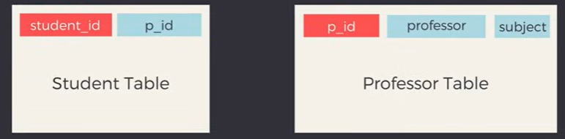

Slide 23
ER Diagrams
ERDiagram was created by Peter Chen in 1976.
The ER model was created to provide a simple and understandable model for representing the structure and logic of databases.
ER models show Entities in a database and how these entities are related to each other.
In simple words they are like design of the database which makes it easier to create tables later.
ER diagrams require no technical knowledge and no hardware support.
These diagrams are very easy to understand and easy to create even for a naive user.

Slide 24
Symbols OF ER Diagram
Figures | Symbols | Represents
Rectangle |  | Entities
Ellipse |  | Attributes
Diamond |  | Relationships
Line |  | Attributes to entities and entity sets
Double ellipses |  | Multi values attribute
Double rectangle |  | Weak Entity

Slide 25
Entity
Entity – An entity is an object with a physical existence or conceptual existence Ex: Person, Car, Company etc
Strong Entity is an entity which has a key attribute
An Entity type has a key attribute that uniquely identifies each entity in the entity set. But some entity type exists for which key attributes can’t be defined. These are called Weak Entity types.

Slide 26
Attributes
Attributes are properties of Entity
Ex: Person is an Entity
Name, Age, Height, etc are attributes of a person
Types of Attributes
Key Attribute Ex; Roll number
Composite Attribute Ex; Address
Multivalued Attribute Ex; Phone
Derived Attribute Ex; Age

Slide 27
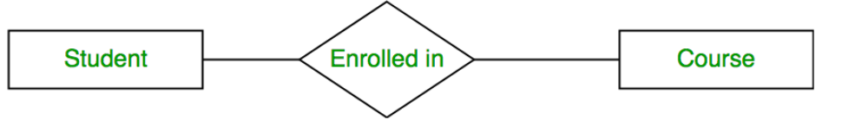
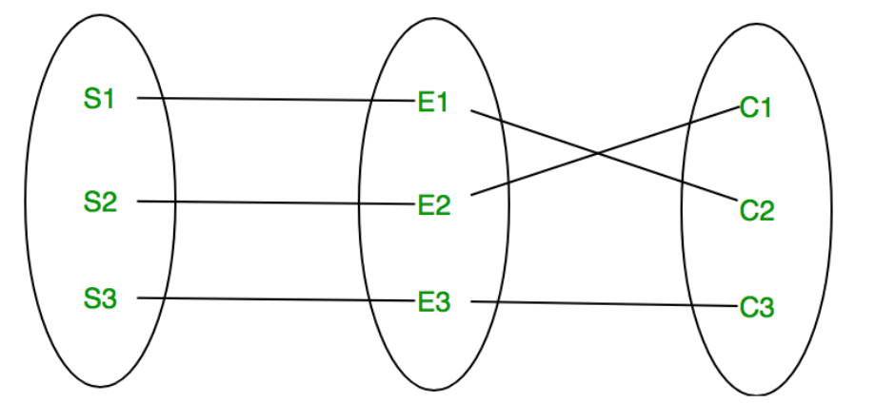
Relationship Type and Relationship Set
A Relationship Type represents the association between entity types.

Slide 28
Degree of Relationship
Unary Relationship – Only one Entity is involved
Binary Relationship – When 2 entities are involved
Students → Enrolled to Courses
Ternary Relationship – When there are n entities participating
Married To
Person

Slide 29
Cardinality of Relationship
One to One
Ex: Surgeon and department headed
One to Many
Ex: Department and Doctors
Many to one
Ex: Surgeries done by Surgoen
Many to Many
Ex: Employees working on Projects

Slide 30
Employees and Department
DOJ
Dept ID
Name
ID
Name
Works in
Department
Employee
Manager
has
Manager
DOB
Dependent of
Pro ID
Works On
Projects
Name
Location
Dependents
Gender
Relationship
Name

